Slide 1
Data Analysis Using Python

Slide 2
Need of Data Visualization
Allows us to quickly interpret and adjust different variables.
Commonly Tools Used
Matplotlib (2-D Graph and Plots)
Pandas
Seaborn
Plotly

Slide 3
Data Analysis Using Pandas Data-frame

Slide 4
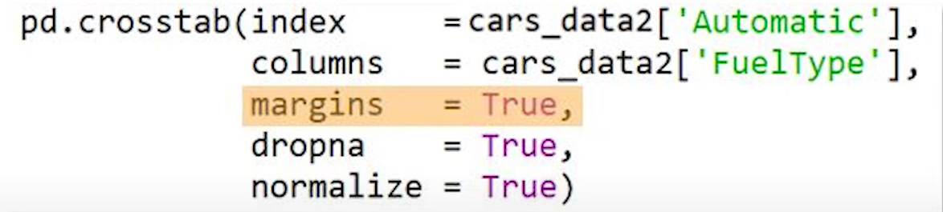
pandas.crosstab()
Used to compute a simple factor for one or more tabs
Used to compute frequency table of factor
Used to compute Joint Probability (Likelihood of two independent events happening at same time)
Used to compute marginal Probability (Probability of occurrence of single event)
Used to compute conditional probability (Probability of event A, given event B already occurred)

Slide 5
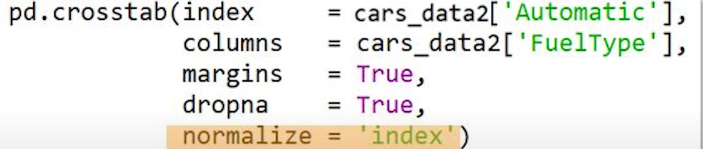
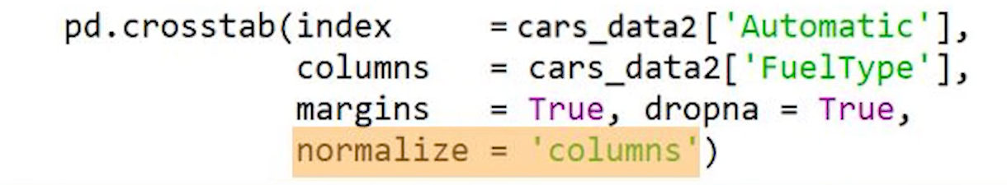
pandas.crosstab()
Used to compute marginal Probability (Probability of occurrence of single event)
Used to compute conditional probability (Probability of event A, given event B already occurred)

Slide 6
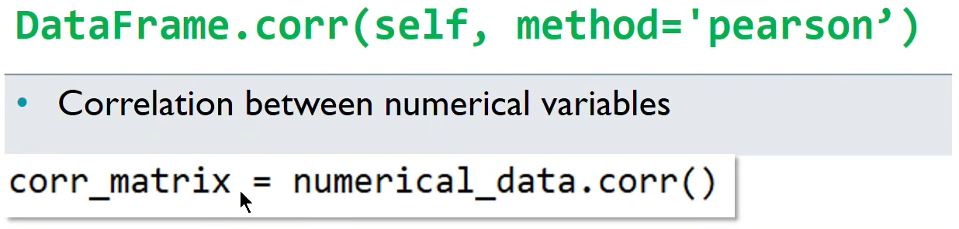
Correlation
Defined as the strength of association between two variables.

Slide 7
Data Analysis Using Matplotlib

Slide 8
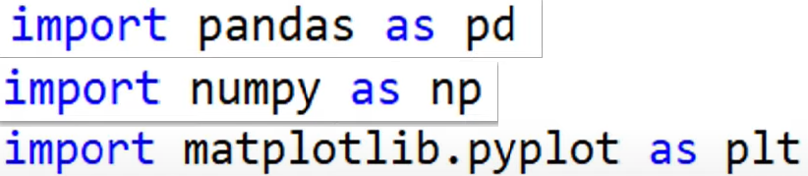
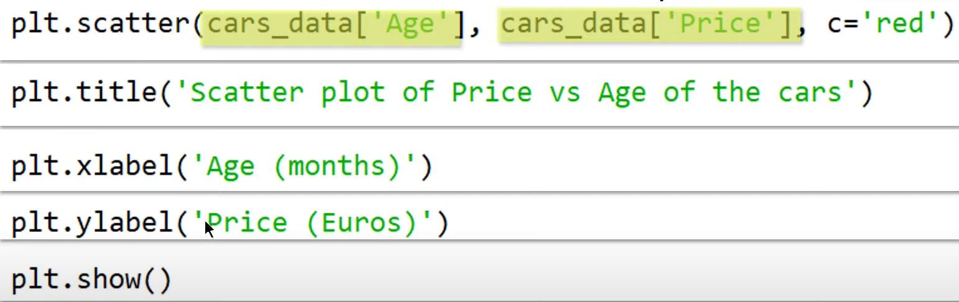
Scatter Point
Set of Points that represents the value of obtained for two different variables plotted on the axes.
Conveys the numerical relationship and correlation

Slide 9
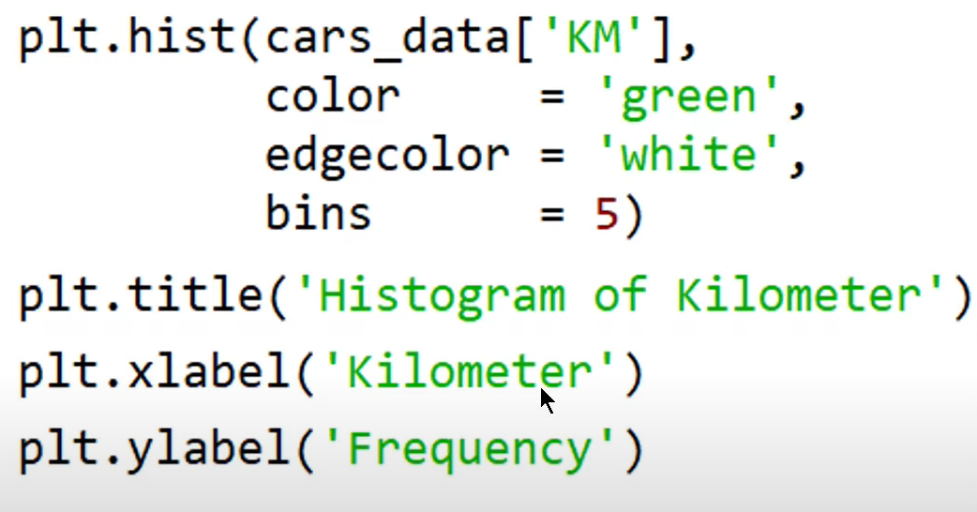
Histogram
Graphical Representation of data using bars of different height
Groups number into range and height of each bar is the frequency of each range.
Represents the frequency Distribution

Slide 10
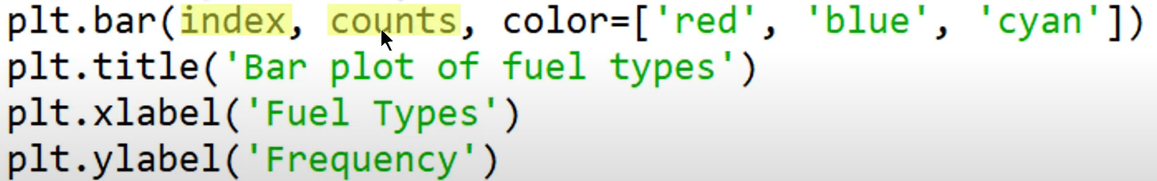
Bar Plots
Presents the calculated value with the rectangular bars with lengths proportional to the counts
Used to compare set of data between different groups.

Slide 11
Data Analysis Using Seaborn

Slide 12
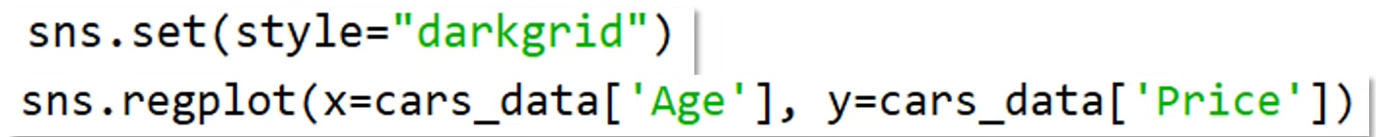
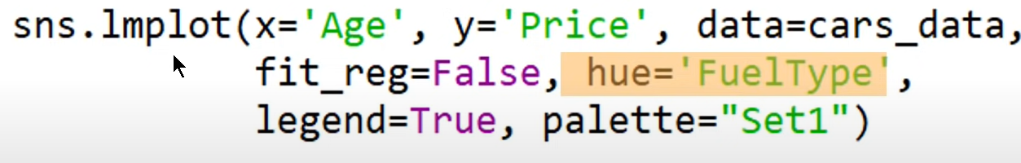
Different Plots
Scatter Plot
For including two different categories
Bar Plot
Histogram

Slide 13
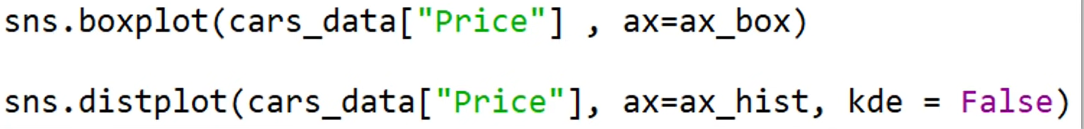
Different Plots
Box and Whisker Plot
Box and Whisker with Bar Plot

